Slide 1
Rigid Body Surface Impact
Dr. Jacob Moore
Associate Professor of Engineering
Penn State Mont Alto

Slide 2
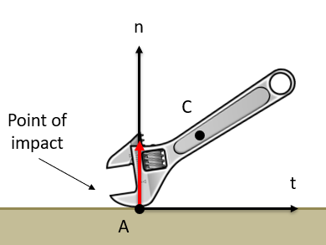
Rigid Body Surface Collisions
When a rigid body impacts a surface, it has the potential to bounce off the surface just like a particle, but there is also the potential for rotation before or after impact, complicating the situation.

Slide 3
Rigid Body Surface Collisions
With a rigid body surface collision, we will often be given a set of velocities before an impact and will need to solve for…
The velocity of the center of mass of the body after impact.
Usually in terms of normal and tangential components
The angular velocity of the body after impact.
Three unknowns, means we will need three equations to work with.

Slide 4
Rigid Body Surface Collisions
In order to generate three equations, we will need to rely on the normal and tangential directions, just as we did with particle surface collisions.
The tangential direction is parallel to the surface
The normal direction is perpendicular to the surface and will be in the direction of the impact forces.

Slide 5
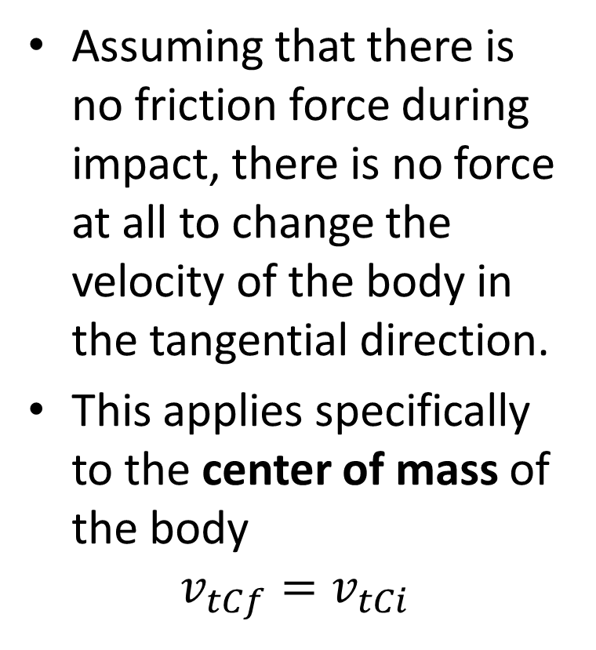
Rigid Body Surface Collisions
Assuming that there is no friction force during impact, there is no force at all to change the velocity of the body in the tangential direction.
This applies specifically to the center of mass of the body
$$v_{tCf}=v_{tCi}$$

Slide 6
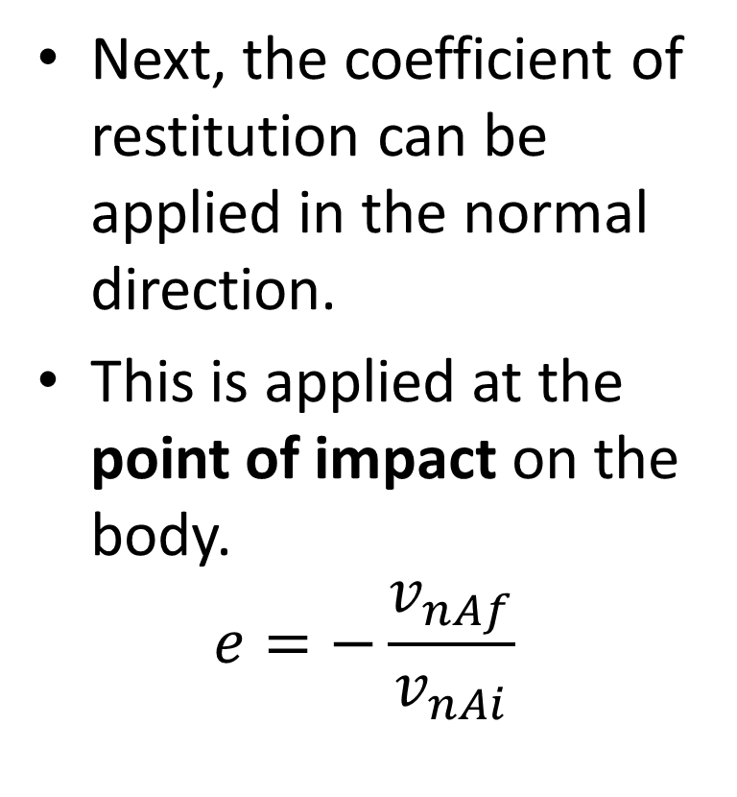
Rigid Body Surface Collisions
Next, the coefficient of restitution can be applied in the normal direction.
This is applied at the point of impact on the body.
$$e=−\frac{v_{nAf}}{v_{nAi}}$$

Slide 7
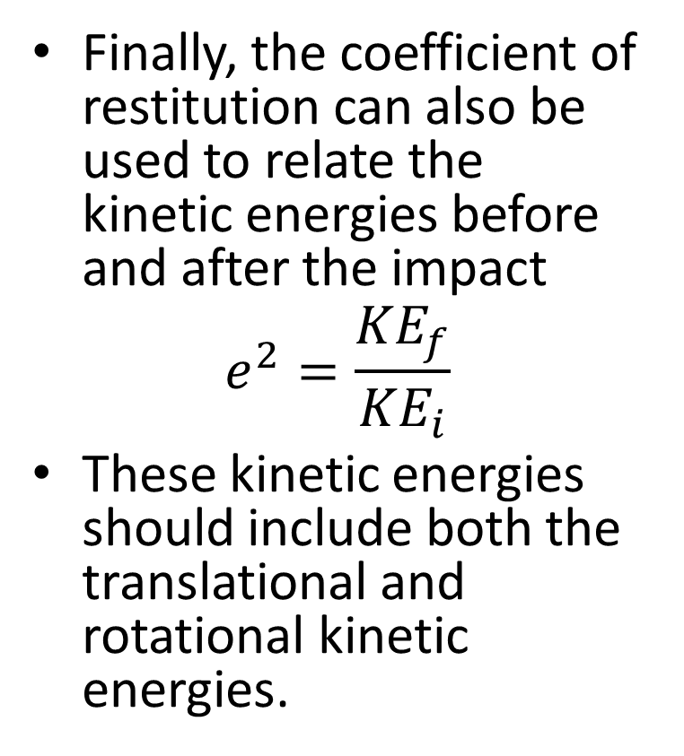
Rigid Body Surface Collisions
Finally, the coefficient of restitution can also be used to relate the kinetic energies before and after the impact
$$e^{2}=\frac{{KE}_{f}}{{KE}_{i}}$$
These kinetic energies should include both the translational and rotational kinetic energies.

Slide 8
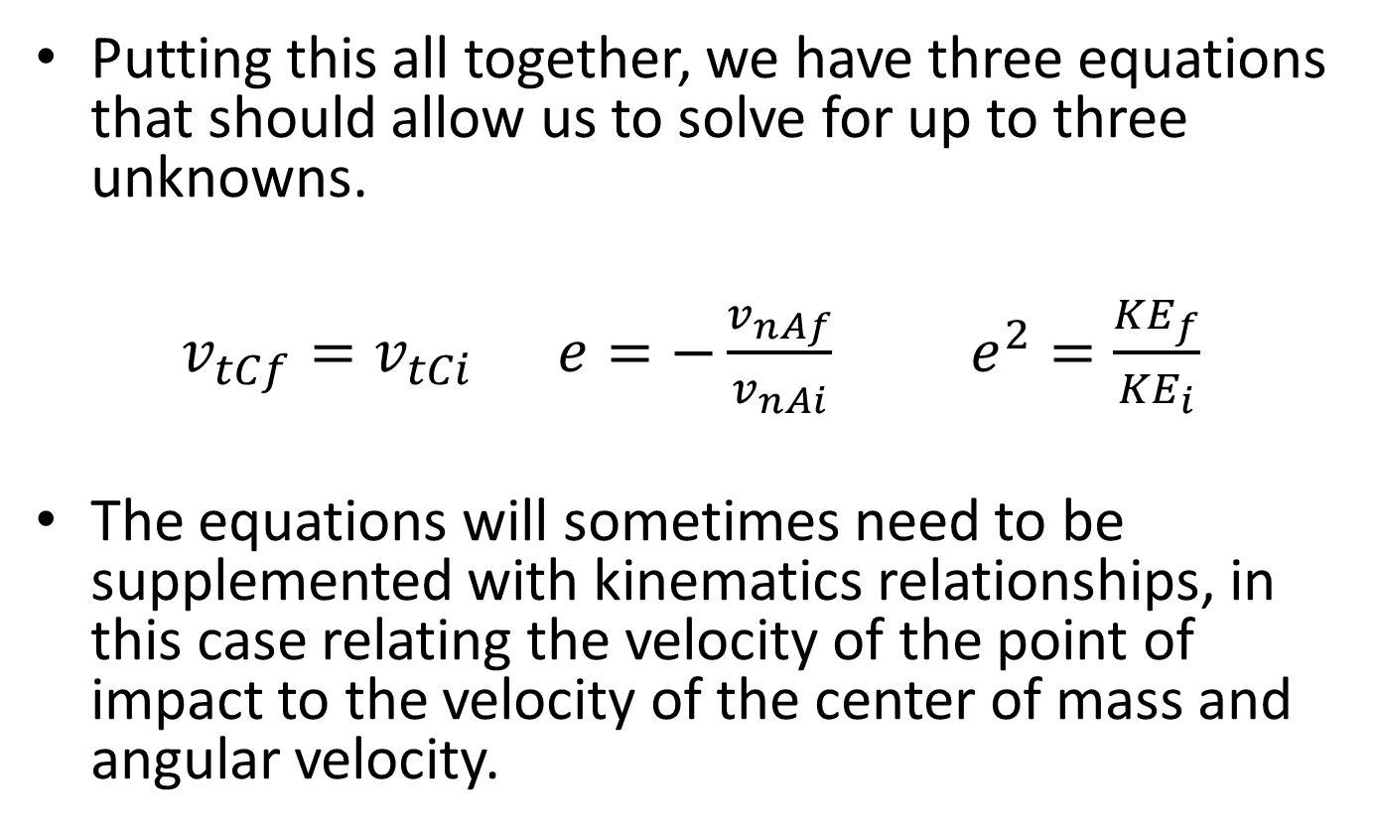
Rigid Body Surface Collisions
Putting this all together, we have three equations that should allow us to solve for up to three unknowns.
$v_{tCf}=v_{tCi}$ $e=−\frac{v_{nAf}}{v_{nAi}}$ $e^{2}=\frac{{KE}_{f}}{{KE}_{i}}$
The equations will sometimes need to be supplemented with kinematics relationships, in this case relating the velocity of the point of impact to the velocity of the center of mass and angular velocity.

Slide 9
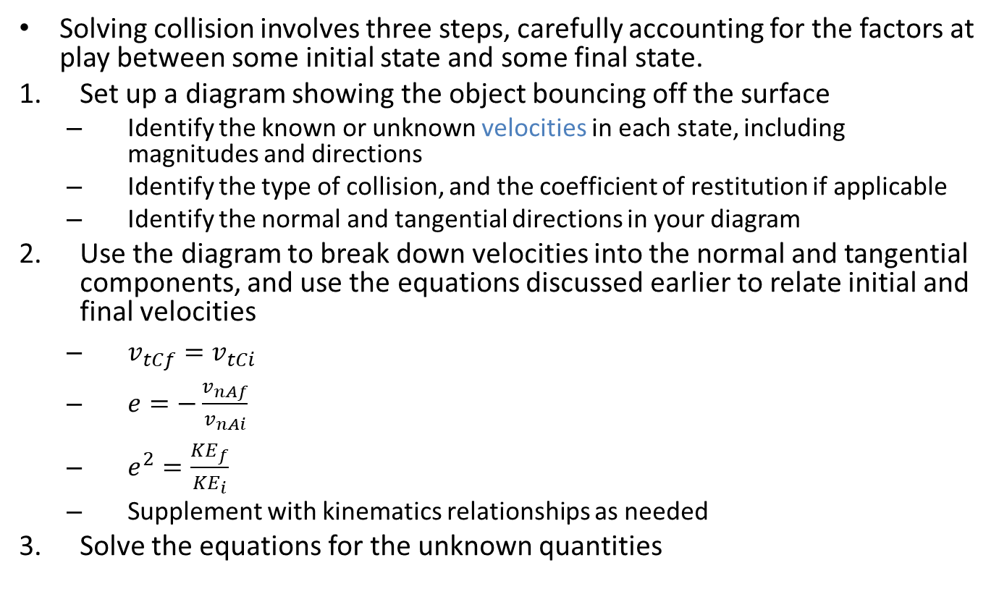
Solving a Collision Problem (The Process)
Solving collision involves three steps, carefully accounting for the factors at play between some initial state and some final state.
Set up a diagram showing the object bouncing off the surface
Identify the known or unknown velocities in each state, including magnitudes and directions
Identify the type of collision, and the coefficient of restitution if applicable
Identify the normal and tangential directions in your diagram
Use the diagram to break down velocities into the normal and tangential components, and use the equations discussed earlier to relate initial and final velocities
$v_{tCf}=v_{tCi}$
$e=−\frac{v_{nAf}}{v_{nAi}}$
$e^{2}=\frac{{KE}_{f}}{{KE}_{i}}$
Supplement with kinematics relationships as needed
Solve the equations for the unknown quantities

Slide 10
Thanks for Watching
See other engineering mechanics videos and access the full tool at…

Slide 11
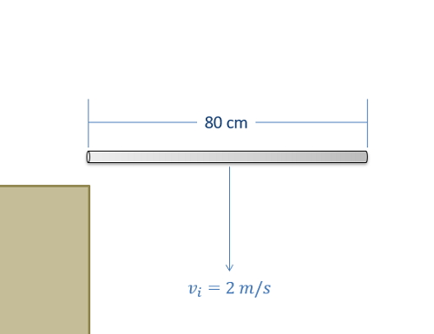
Worked Example
An 80 centimeter long 1 kilogram metal bar falling at 2 meters per second strikes the edge of a table as shown below. Assuming a coefficient of restitution of .9, what is the expected velocity and angular velocity of the bar after impact?

Slide 12
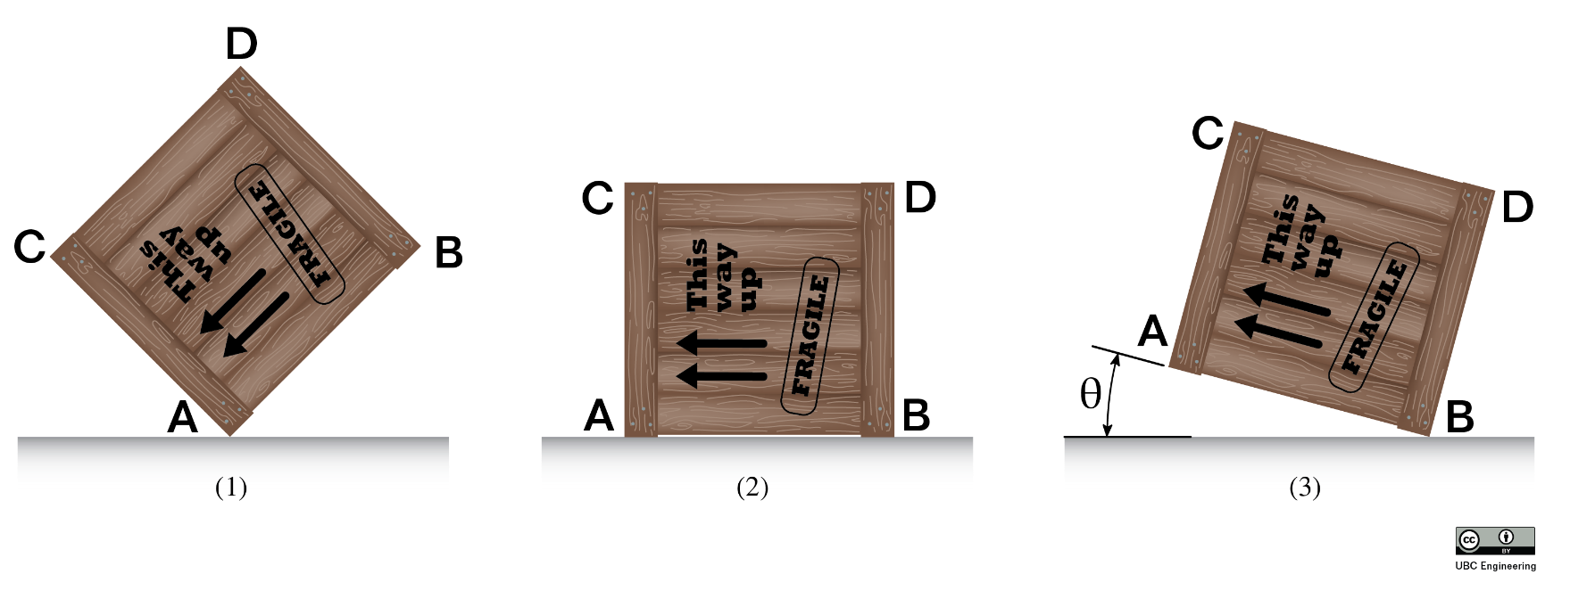
Worked Example
The square crate (dimensions a x a = 0.8 m x 0.8 m, mass m = 20 kg) has an initial angular velocity just before impact of ω₁ = 4 rad/s. It impacts the ground at corner B (perfectly plastic impact). Determine the angle, θ, through which the crate will rotate upwards and the percentage of energy lost in the impact. Assume friction prevents slipping throughout.

Slide 13
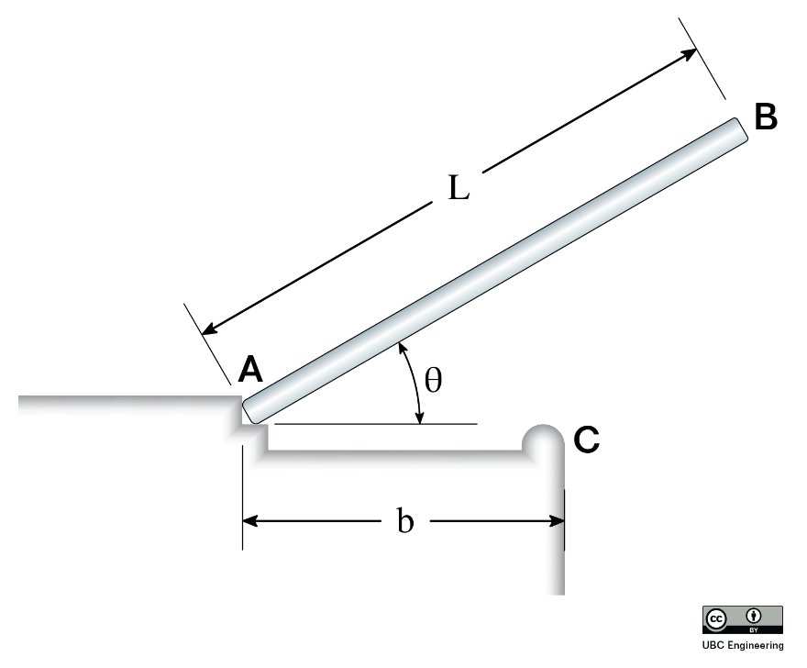
Worked Example
The rod AB (length L = 2 m, mass 15 kg) falls from rest from an initial angle of θ = 30 degrees. It impacts the corner C (b = 1.3 m). Determine the angular velocity, ω, and the velocity of the rod’s center of gravity, v_{G}, just after impact.

